Slide 1
Partnership Opportunity
WORLD GREEN BUILDING WEEK 2024

Slide 2
World Green Building Week
The Green Building Week celebrates sustainability in the built environment and raises awareness on the great impact that buildings have on the environment, economies, and communities.
This year EmiratesGBC is hosting a series of events to mark the World Green Building Week. The events will span across 3 days and will host different activities including roundtable, panel discussion, and professional networking. Aiming to bring various stakeholders from government, private sector and academia all together.

Slide 3
SPONSORSHIP PACKAGE OVERVIEW
Platinum Partner
(Full 3-day Sponsorship)
10,000 AED
Session Partner
(1-Day sponsorship)
5,000 AED

Slide 4
SPONSORSHIP PACKAGE BENEFITS
World Green Building Week Series Sponsorship Benefits | Platinum | Session
Pre Event Promotion & Online Branding
Branding on Social Media Posts | On all event posts | Posts related to sponsored session
Branding on Green Building Week Email campaigns | x | x
Hyperlink from EmiratesGBC email campaigns to sponsor website | x | x
Special announcement of sponsorship on Social Media channels | x | x
Special "Meet the Sponsor" mailer sent out | x | x
Media & Communications
Quote in event Press Release | x | x
Sponsor name to be mentioned in all EmiratesGBC Green Building Week press release | x | x
Branding on online collateral promoting the World Green Building Week | x | Posts related to sponsored session
At the Event
Branding on the EmiratesGBC World Green Building Week agenda (electronic) | On all sessions | 1 Session
Option to distribute giveaways | x | x
Opportunity to participate in the event | x | x
Branding on printed collateral (signage & banners) | On all sessions | 1 Session
Special thank you to be announced at the beginning and end of the session | On all sessions | 1 Session
Branding on AV screen saver | On all sessions | 1 Session
Front row seats for panel discussion and workshop sessions (CEO level) | On all sessions | 1 Session
Option for one commercial to be played during networking break (2-3min) | x
After the Event
Special thank you & branding in the event brief | x | x
Cost (UAE Dirhams) | 10,000 | 5,000

Slide 5
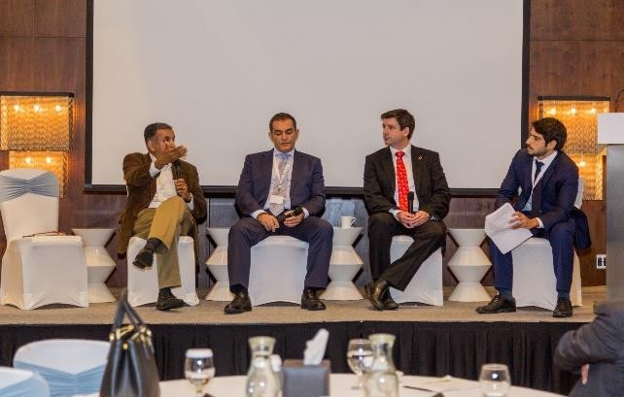
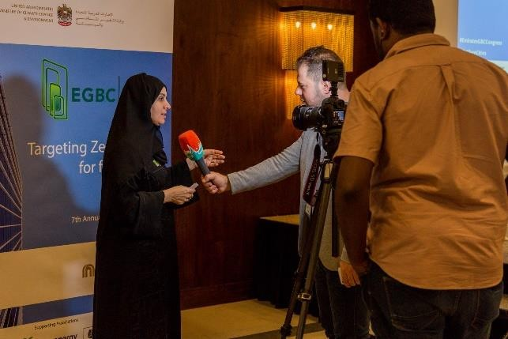
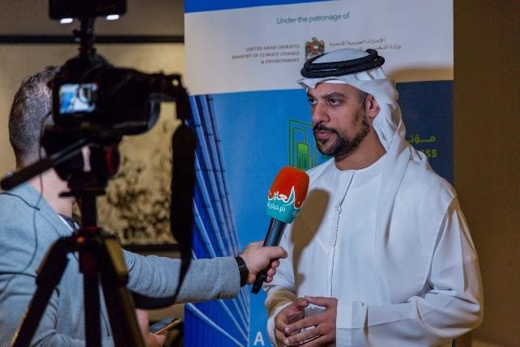
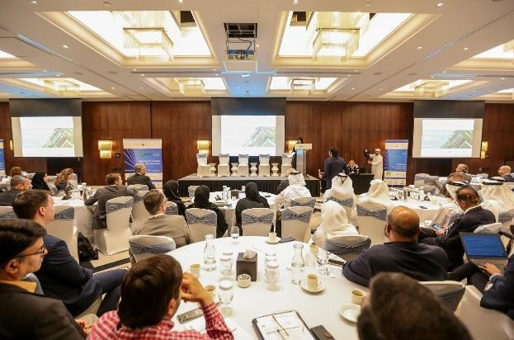
BENEFITS OF PARNTERSHIP
Demonstrate sustainability leadership
Event participation for employees
Media coverage for your organization
Long term brand exposure & visibility across EmiratesGBC’s network
Networking opportunities
Support the green building movement in the UAE and beyond

Slide 6
To pursue a sponsorship opportunity, please contact events@emiratesgbc.org or call 04 346 8244 Thank you!

