Slide 1
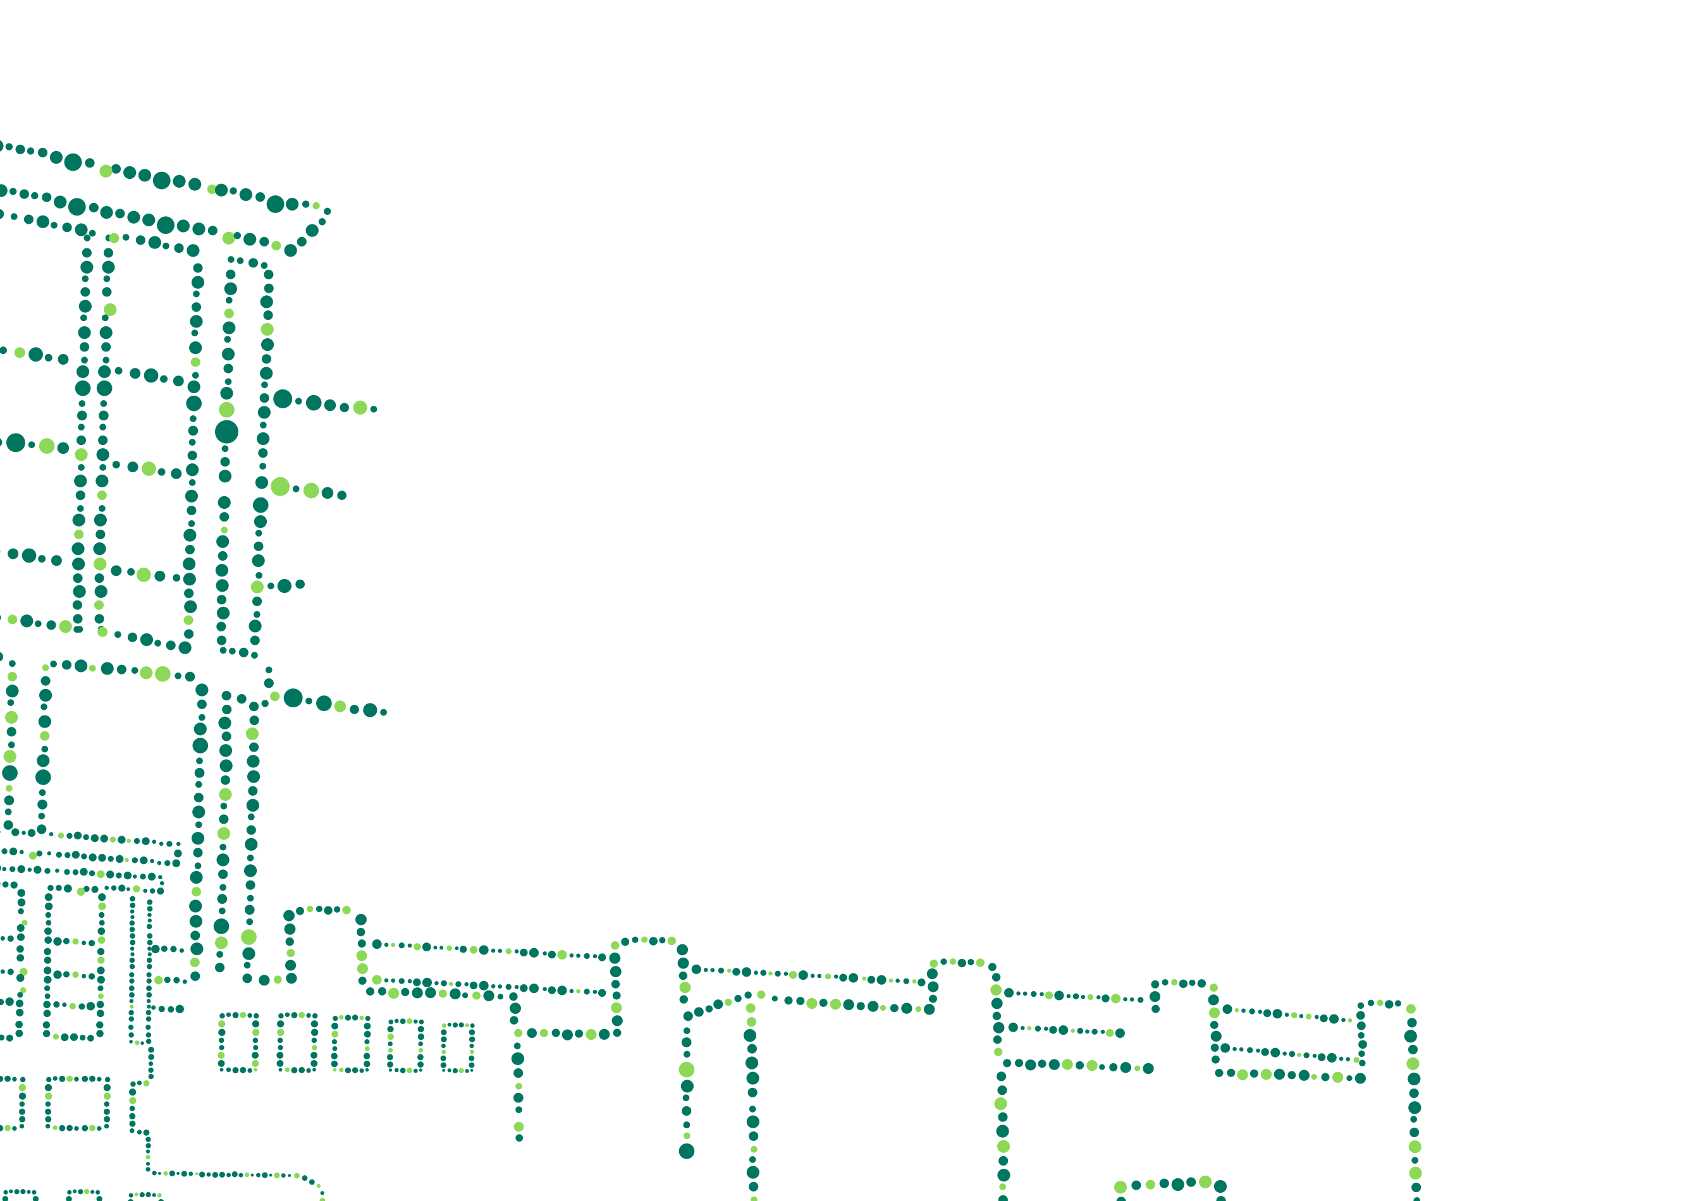

EmiratesGBC Technical Workshops by SkyTech Engineering LLC-FZ
Breathing Green: The Evolution of Living Walls for Energy and Air Quality Solutions
Presented by Pio Vitharana, Managing Director
12th of January 2024

Slide 2

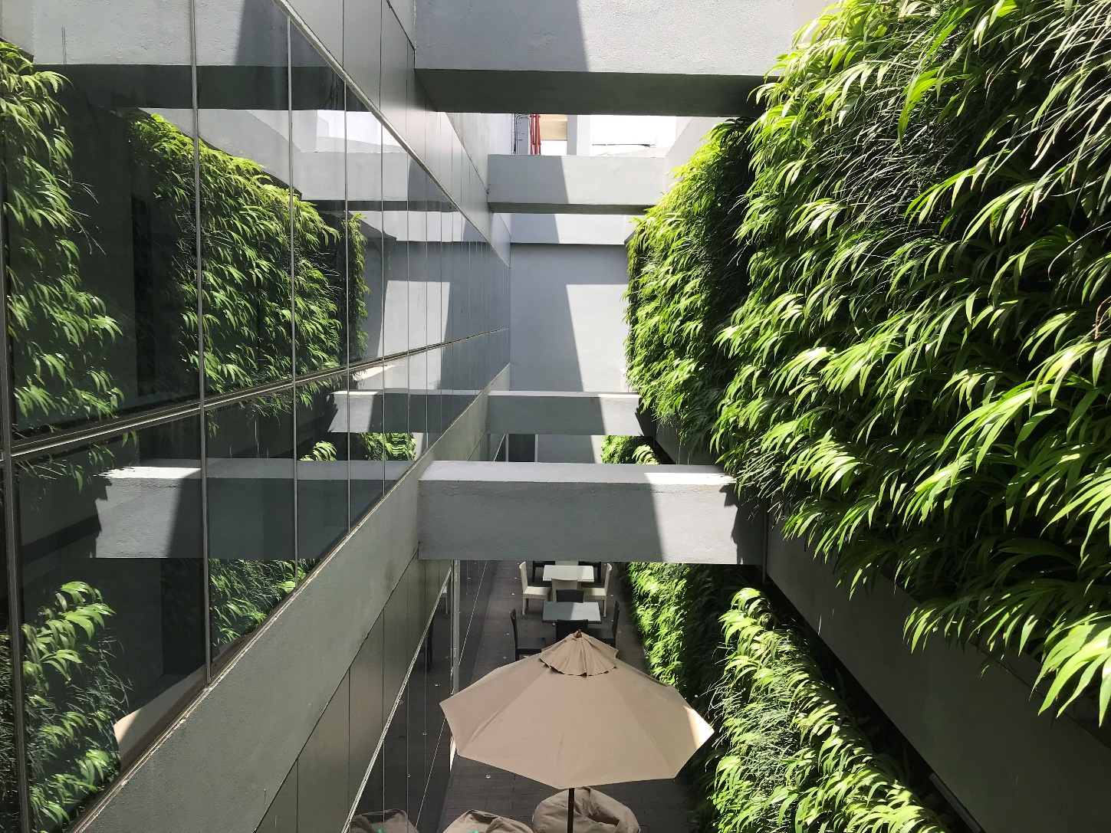
"Breathing Green: The Evolution of Living Walls for Energy and Air Quality Solutions"

Slide 3



U.A.E
SkyTech Engineering L.L.C-FZ,
Tanvi Business Center,
Airport Road, Port Saeed,
Deira, DUBAI U.A.E
PO BOX 77880
URL: www.skytechen.com
e-mail: info@skytechen.com
Sri Lanka
Factory & Office
SkyTech Engineering (Pvt) Ltd
#23, First Lane, off Templars Road,
Mount Lavinia, Sri Lanka.

Slide 4
Types of Green Walls
Active | Passive
No solid growing media Hydroponic Type water based nutrients continuously moving or falling to the roots of the plants | Soil or Soil like growing media Available
Continuous operation of Pumps to transfer liquid based nutrients to roots | Low maintenance and operational cost
Continuous maintenance mechanisms to control nutrients NPK, PH in the liquids through advanced technological components. | Works along with HVAC systems in harmony
High maintenance cost

Slide 5
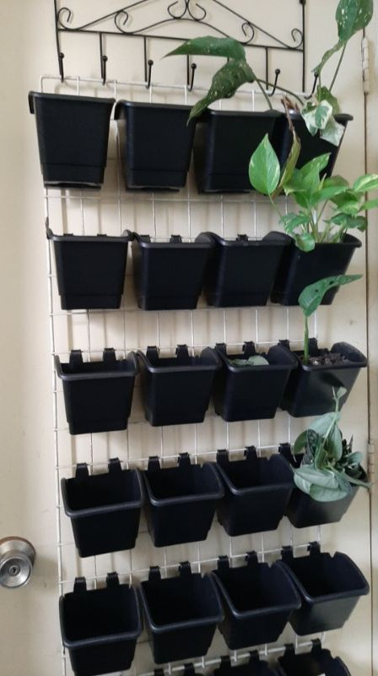
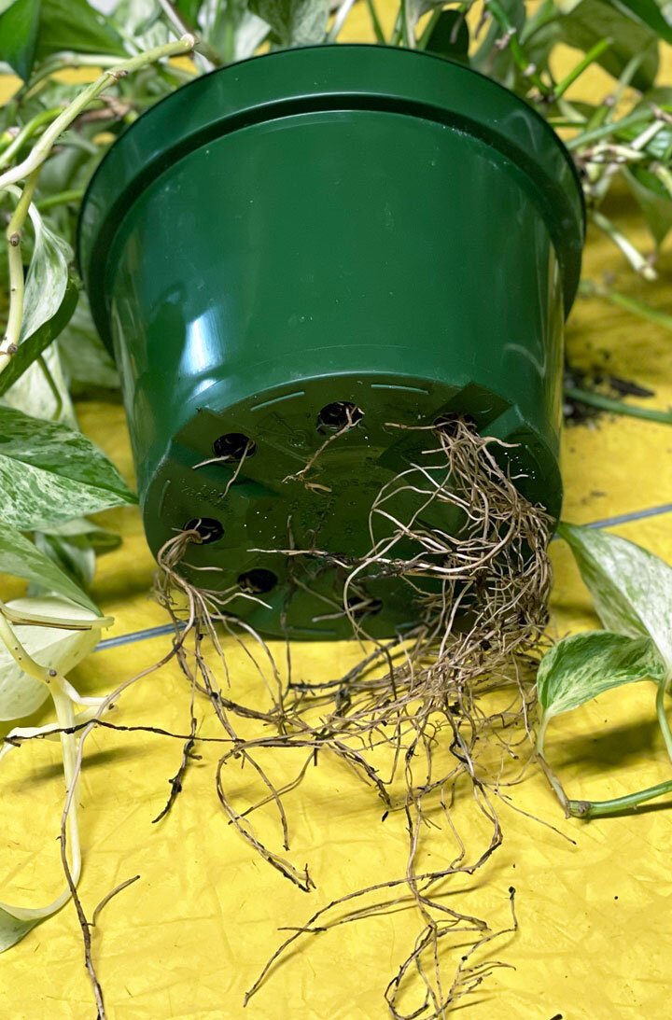
Plastic Pot Vertical Garden- Passive Type
 | Characteristic | Problem
1 | Aeration only from the top layer of the soil | Soil get compressed disturbing the plant growth
2 | Excess water drained out only from the pot holes at the bottom | Roots grow in search of air and block the excess water drainage holes at the bottom
3 | Outside heat is excessively absorbed to the pot wall as the plastic pot cover is heavily exposed. | Disturb the healthy Root Growth
4 | Maintenance- | Loosening of pot soil is required frequently and may be difficult at heights

Slide 6
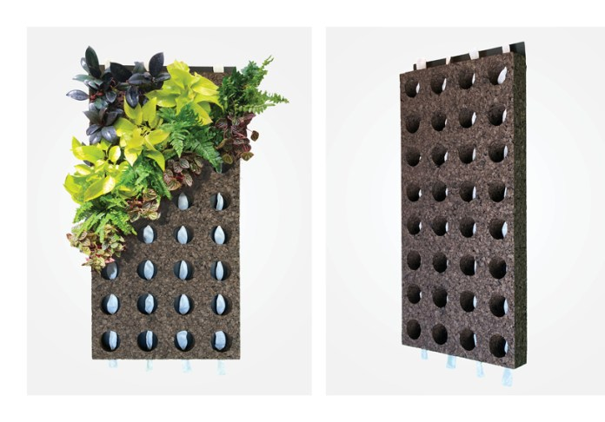
Coke Based Vertical garden- Passive Type
 | Characteristic | Problem / Solution
1 | Better aeration due to the coke based growing media | Good for plant growth
2 | Excess water efficiently transferred to the bottom plants | Better for plant growth
3 | Roots are better protected from outside heat as there is no heat absorption material is exposed. | Better for plant growth
4 | Irrigation points at intervals | Good for plant growth
5 | Maintenance- | Durability is comparatively lower and there is a risk of collapsing with the decays of coke materials.

Slide 7
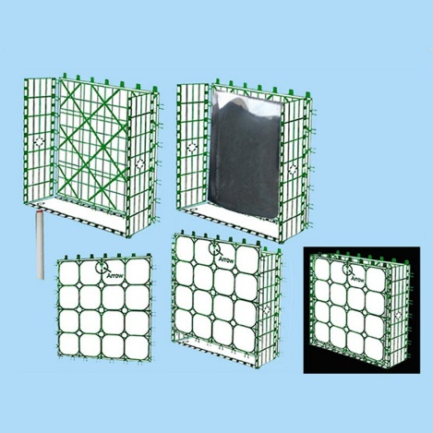
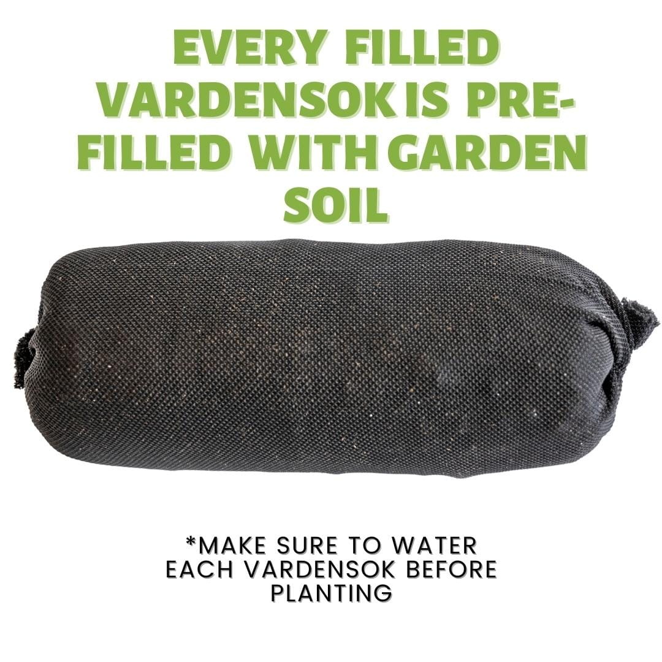
Panel or Modular System Vertical Gardens- Active Green Wall
 | Characteristic | Problem and Solution
1 | A guard to protect the plants and growing media falling | Risk of collapse is solved due to the guard in front
2 | Better aeration due to the openings on all sides | Plants are inserted to the structure with soil filling bag like a root ball covered with a felt based pouch
3 | Drip irrigation system available in intervals | The water is penetrated efficiently when the pouches are new.
4 | Absorption of outside heat | Since the manufacturer has designed the structures to minimize the plastic content, absorption of excess heat is minimized.
5 | Roots are better protected from outside heat | Fabric pouch protect the roots from outside heat
6 | Maintenance | Maintenance cost is comparatively high due to the fact that the water is required to absorb through the outer wall of its soil filling bags.

Slide 8
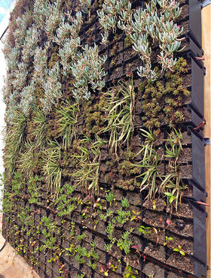
Panel or Modular System Vertical Gardens
 | Characteristic | Problem and Solution
1 | Angular planting pot shape | Stable structure
2 | Better aeration due to the wide openings in the front | Better aeration good for plant growth
3 | Drip irrigation system available in intervals | The water is penetrated efficiently good for plant growth
3 | Absorption of outside heat | Manufacturer has designed the structures to minimize the plastic content exposed.
4 | Maintenance- | Easy as the panels with plants are easy to exchange and nurture.

Slide 9
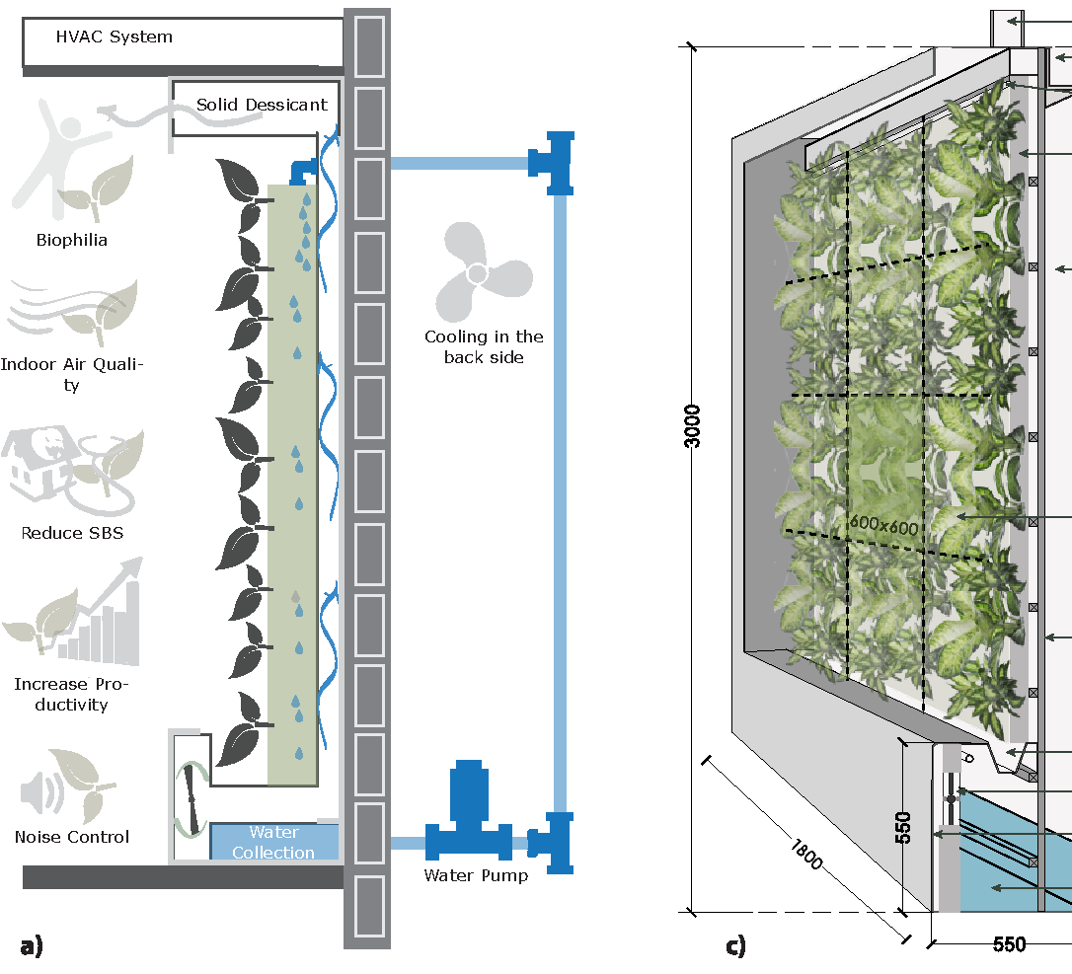
Active Green walls
 | Characteristic | Problem and Solution
1 | No solid growing media | Hydroponic Type, water based nutrients continuously falling to the roots of the plants Help to get away from soil based pests
2 | Better aeration to the roots | Due to wide exposure of the roots to the air plants grow better
3 | Continuously running motors, and nutrient gauging equipment | Consume more energy
3 | Absorption of outside heat | Outside heat is perfectly absorbed from the liquids
4 | Humidity | Ads more humidity to the surroundings and increases relative humidity.

Slide 10

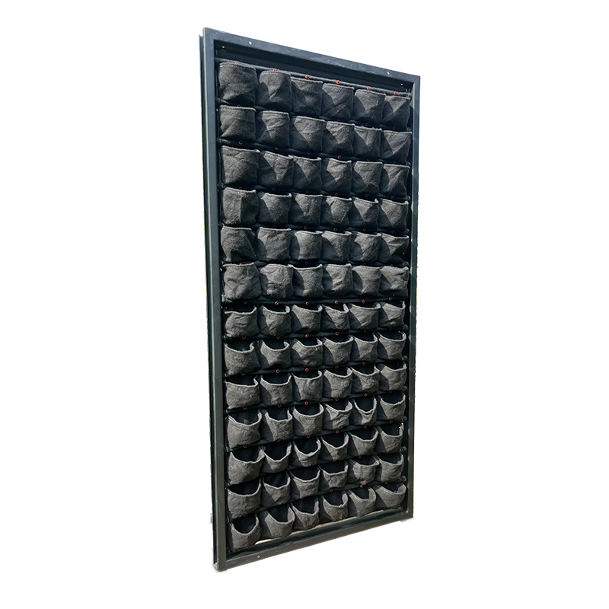
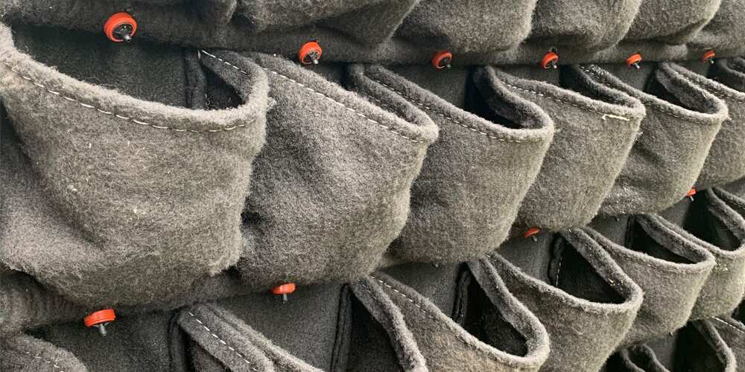

Panel or Modular Fabric Pocket Vertical Gardens
  2 lph Dripper to each and every pot
  2.5 Liters of soil to each pot

Slide 11
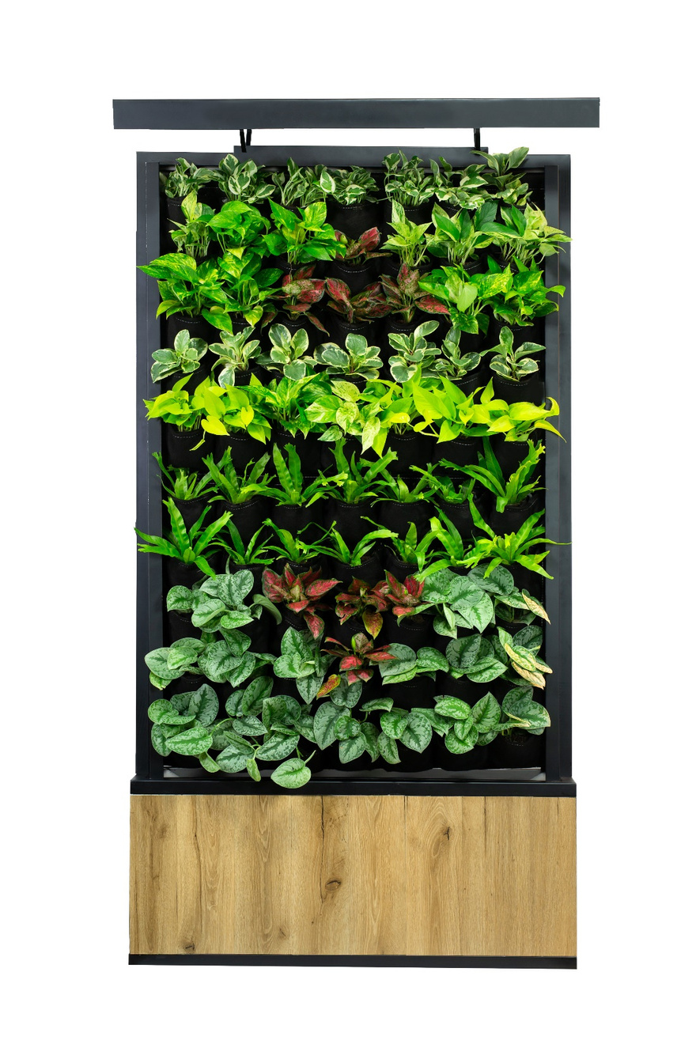
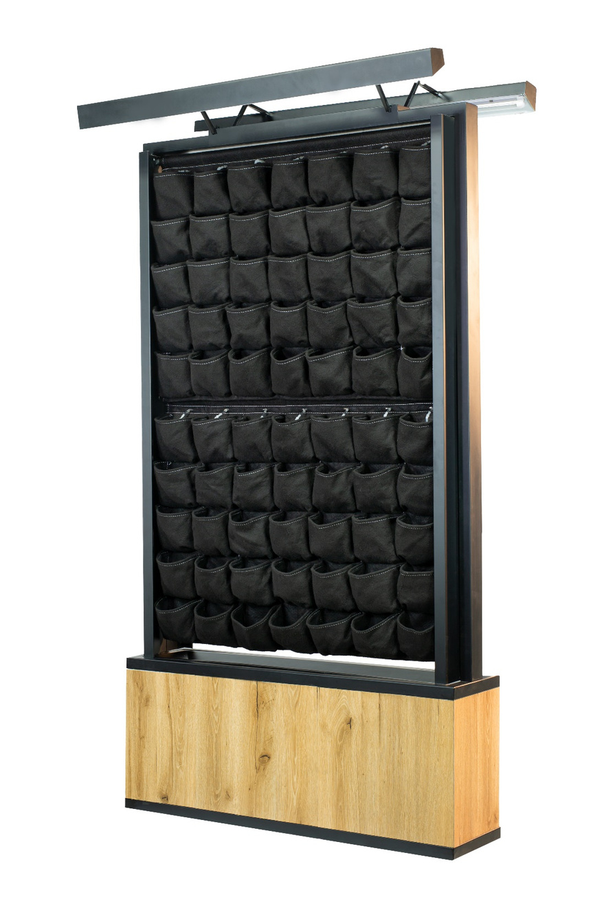
Stand-alone Type Green Wall for Indoors
Comes with..
Powerful Grow lamp,
WIFI assisted fully automated water pumping system
Inbuilt water tank
Fabric Pocket structure

Slide 12
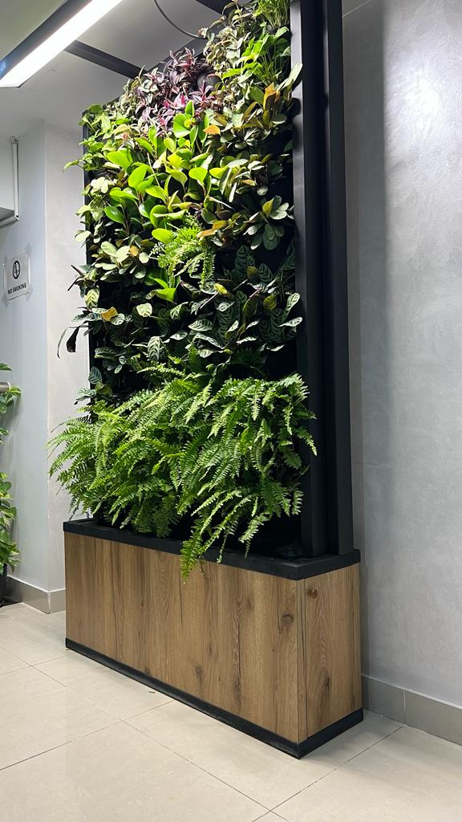
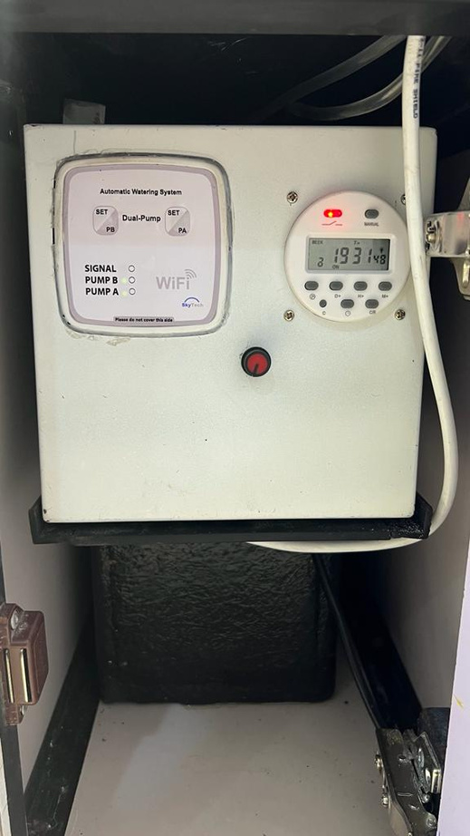
CONTROL PANEL
WIFI-assisted
Water Pump
Timer for the
Grow Lamps
Grow Lamp Dimmer

Slide 13
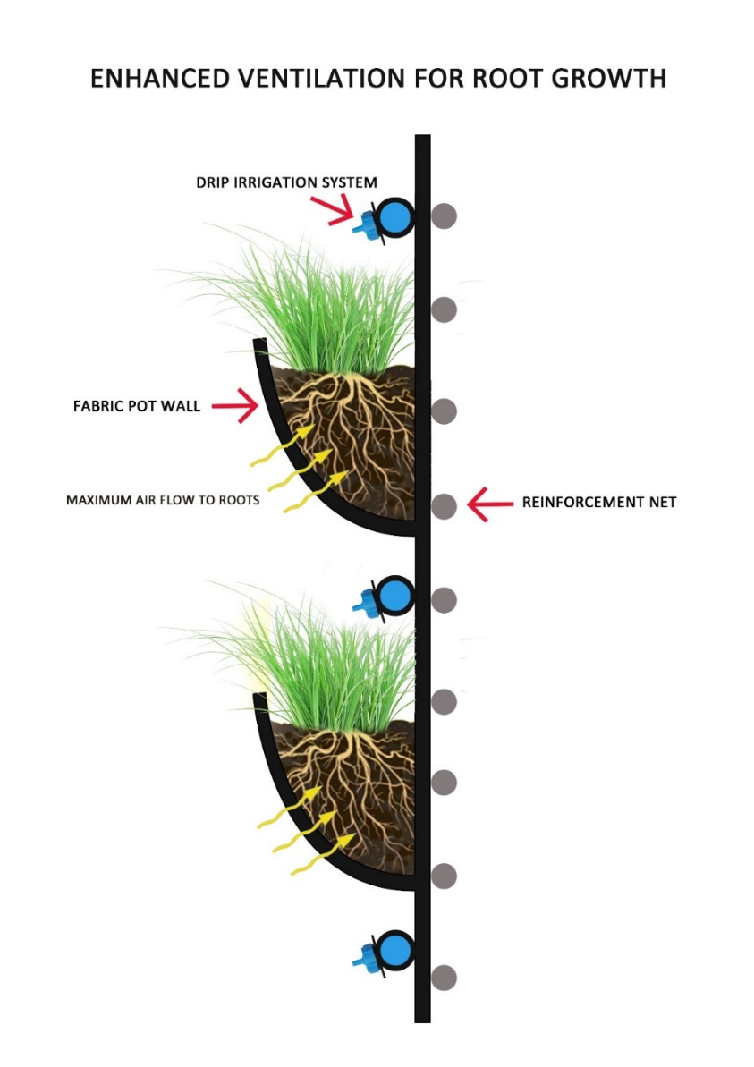
Salient Features of SkyGrow Fabric Green Wall System
Enhanced Ventilation for Better Root
Growth
2. Harmful Pollutants such as VOC’s and PM’s
are perfectly absorbed to the roots through
the fabric

Slide 14
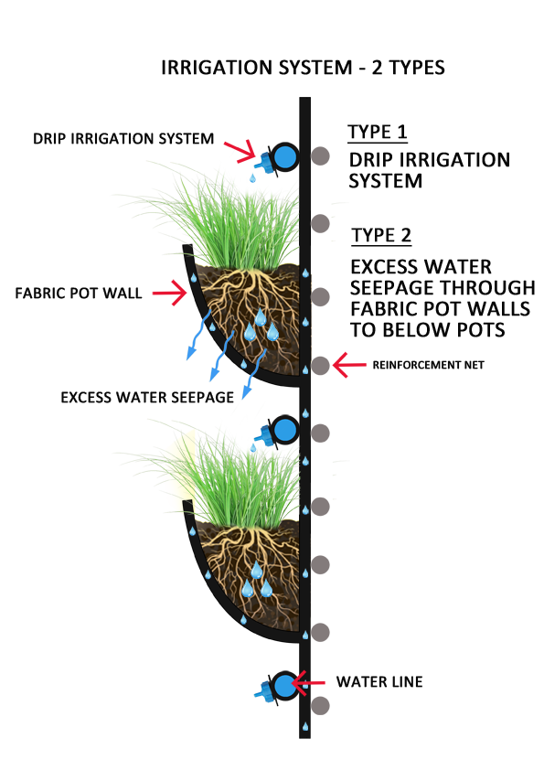
2. Efficient Water Drainage by the Entire Wall System

Slide 15
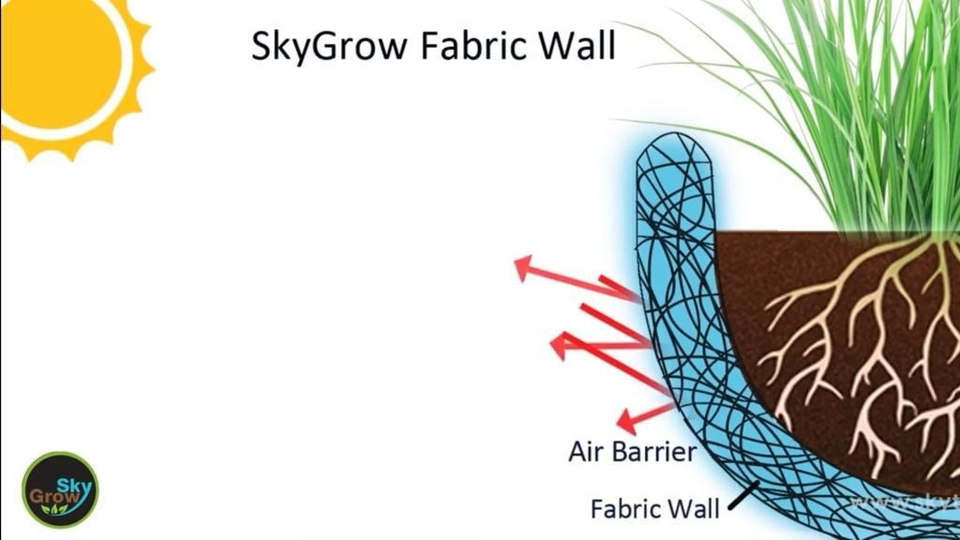
3. Protection from Outside Heat

Slide 16
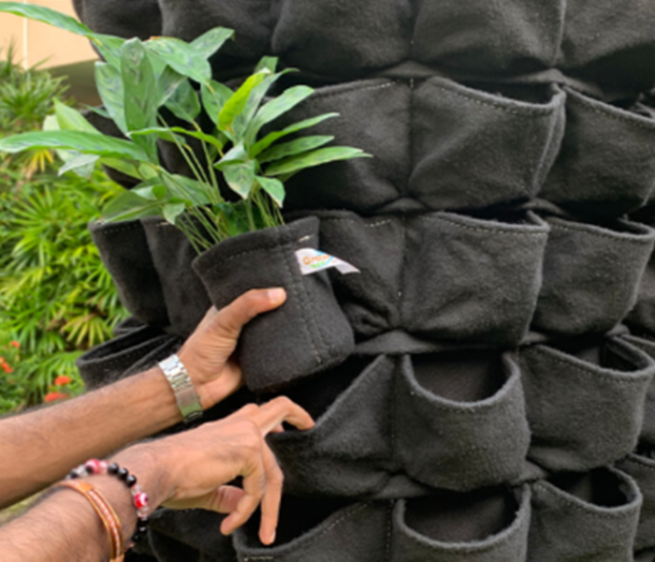
4. Easy plant installation

Slide 17
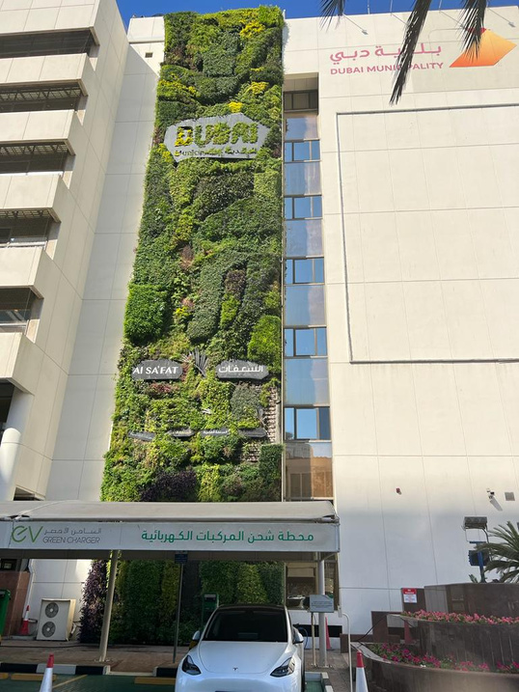
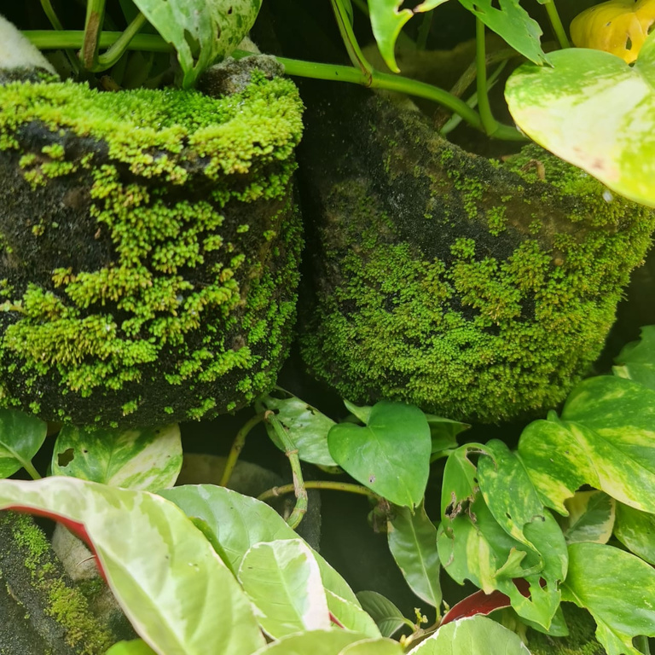
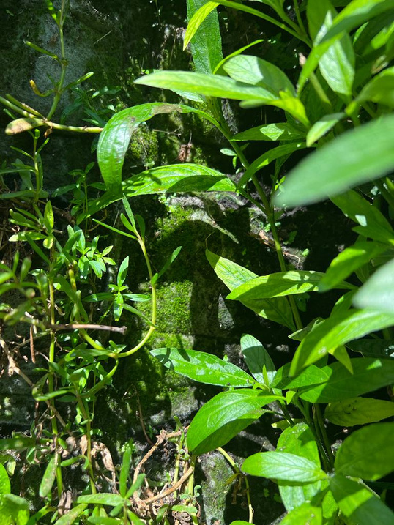
Outcome
Dubai Municipality
Plants thrive in and on the surface of the planting pockets

Slide 18
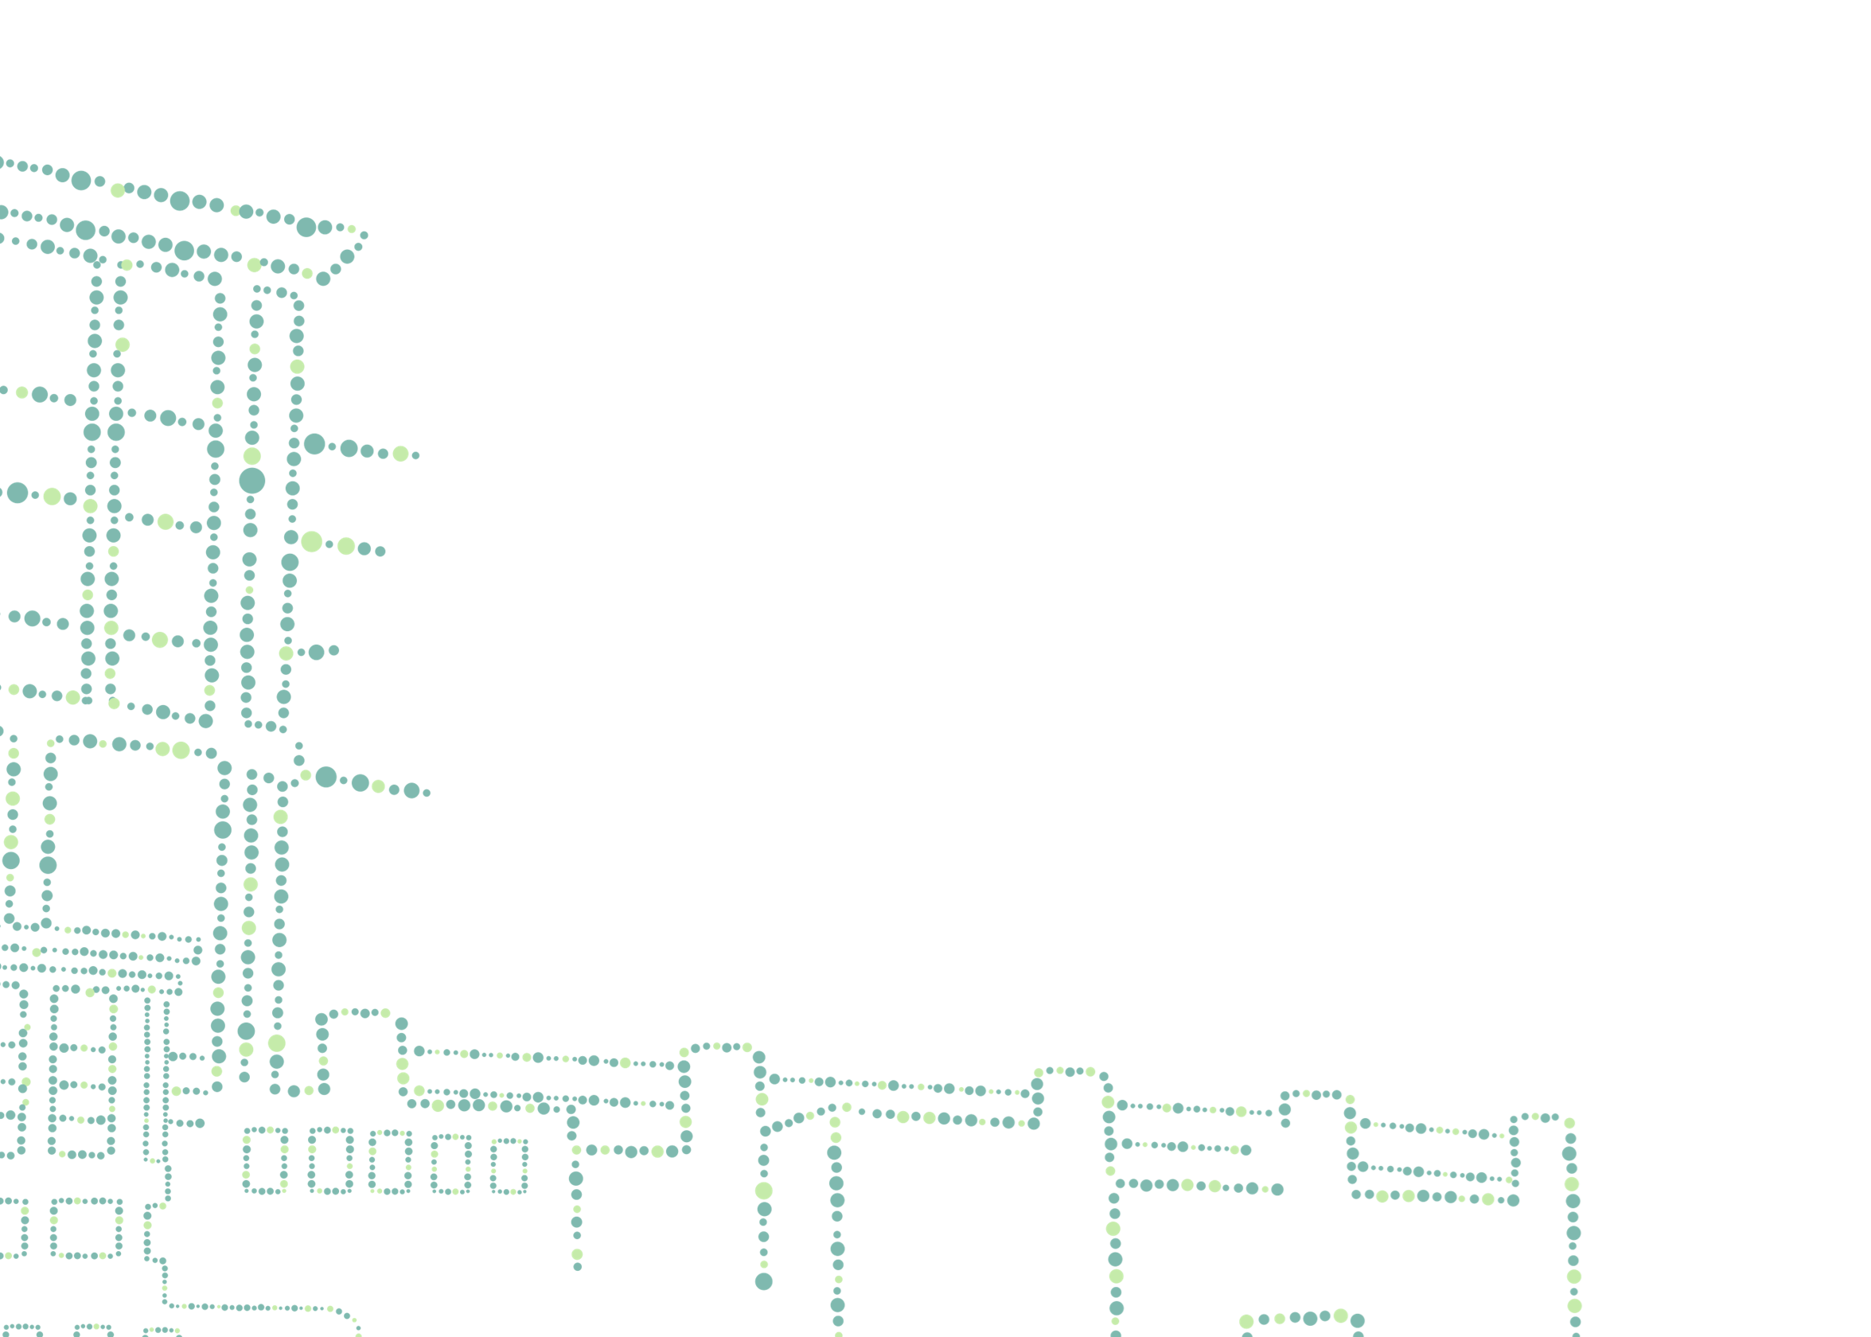
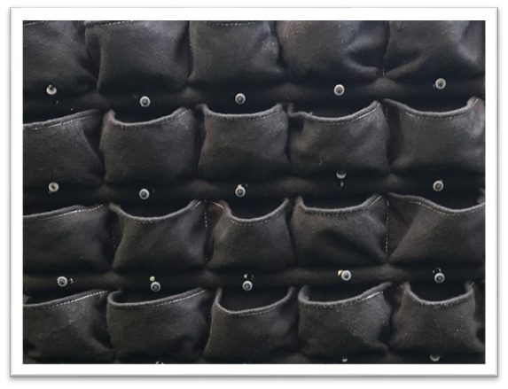
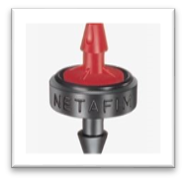
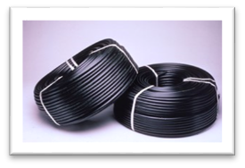
SkyGrow Components
Fabric
Specially engineered high strength UV stabilized Virgin quality PP fabric material Imported from Italy
Stitched by SkyTech Engineering using UV-stabilized Spanish made thread
Drippers
2lph PC type
Imported from Turkey
Lateral Line
LLDP 5bar , 16mm
Imported from Spain
Steel Structure
Galvanized and painted with marine quality paint

Slide 19
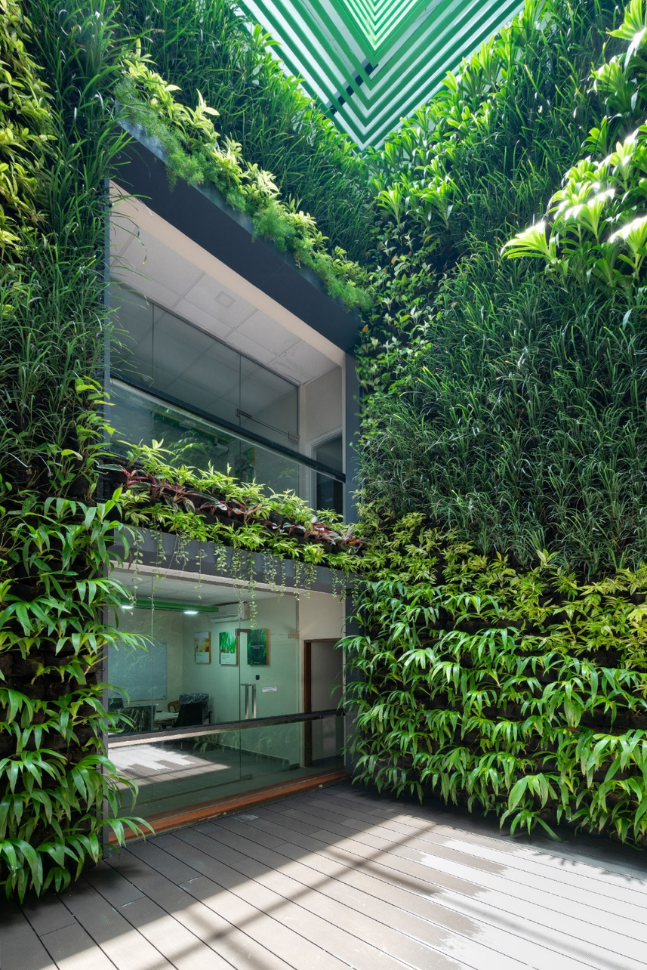
How Green Walls Benefits..
Indoor Passive Green walls- effectively reduce the indoor carbon dioxide loads and reduce the requirements for the building mechanical ventilation system.
2. Outdoor Green Walls- reduce building surface temperature
resulting in reducing the need for costly heat reducing
methods.
3. Improves indoor air quality by absorbing harmful pollutants

Slide 20
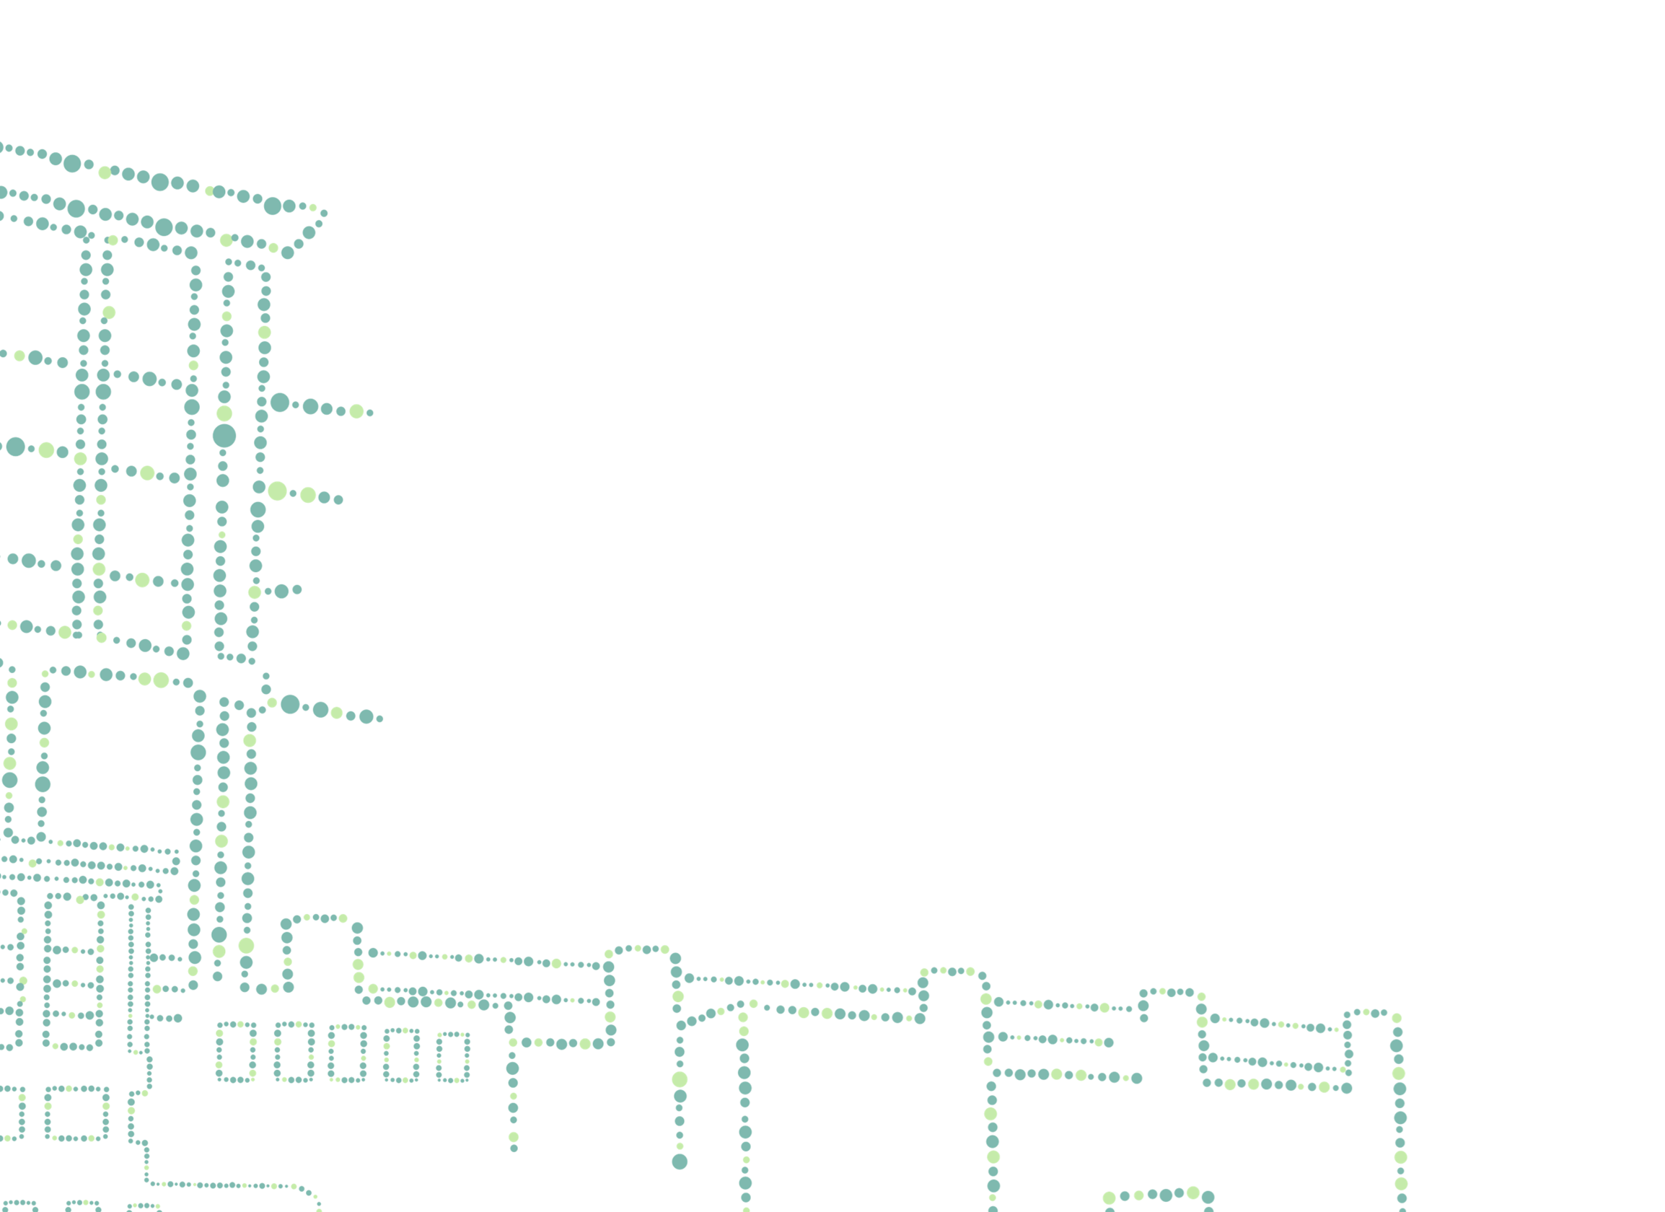
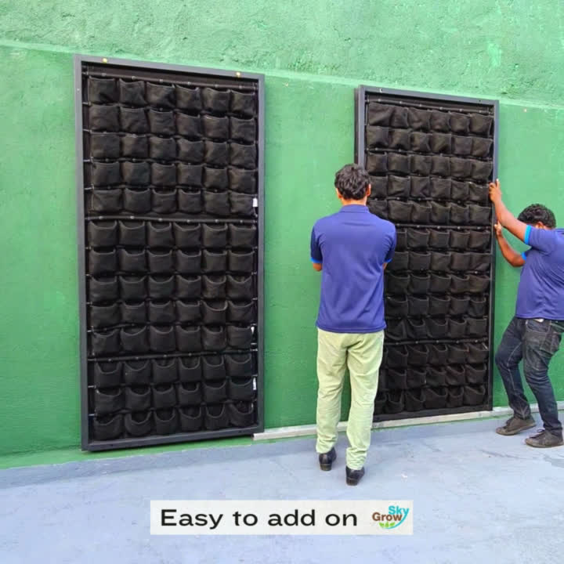

Slide 21
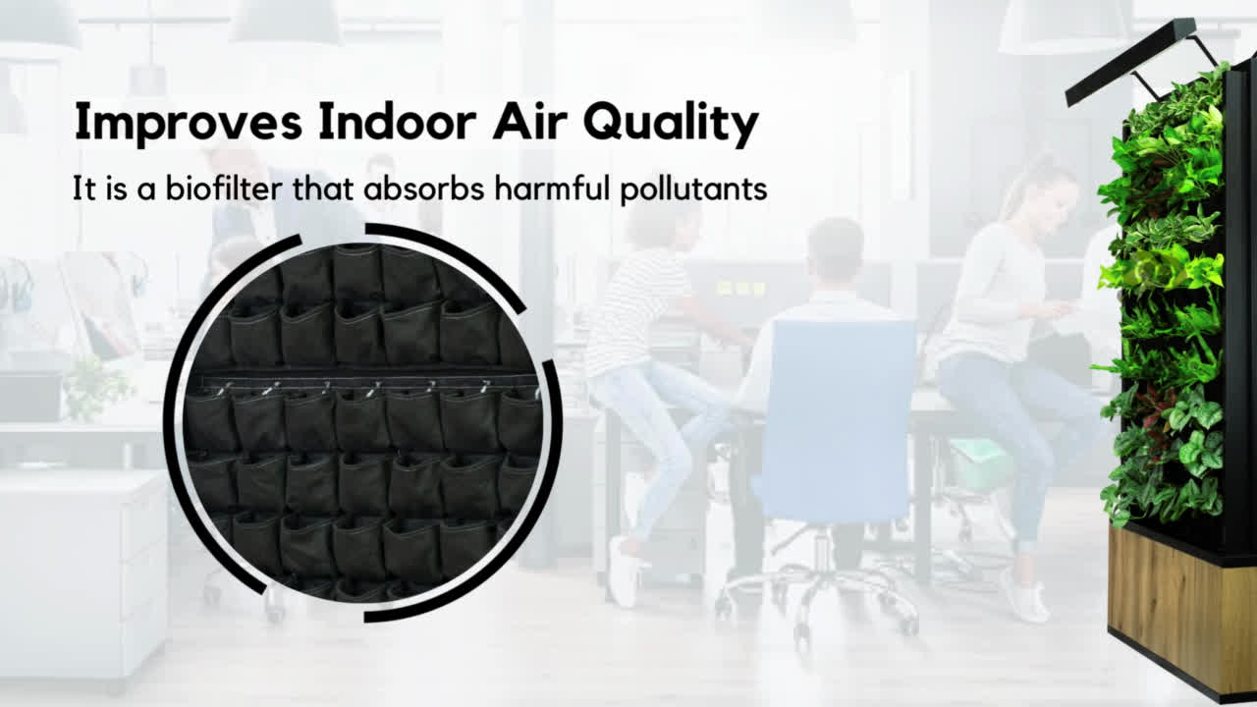

Slide 22
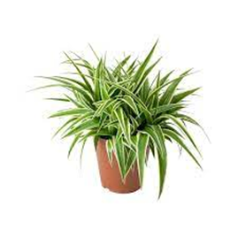
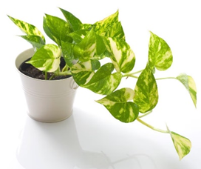
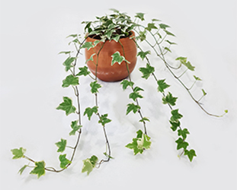
Types of Live Plants Proposed
Image | Plants |  | VOC removal rate | CO2 removal | PM removal
 | (Chlorophytum comosum) | Spider plant | 10.4% - Formaldehyde | 5.49 g/h Airflow: 3.5 m/s | 53.35 ± 15.99% Airflow: 11.25 L s
 | (Epipremnum aureum) | Devil's Ivy or Pothos | 73.2% - Benzene 9.2% - Trichloroethylene | 1.36 g/h Air flow: 3.5 m/s
 | (Hedera helix) | English Ivy | 89.8% - Benzene 10.9% - Trichloroethylene

Slide 23
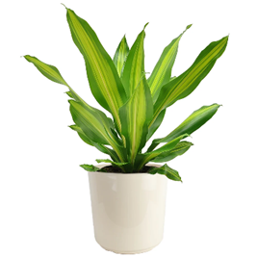
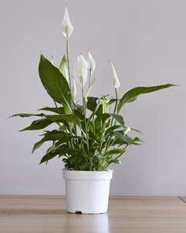
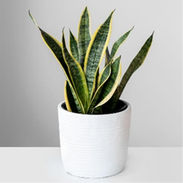
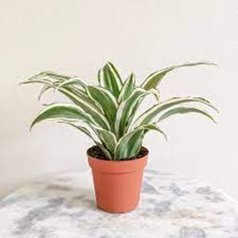
Types of Live Plants Proposed
Image | Plants |  | VOC removal rate | CO2 removal | PM removal
 | (Dracaena spp.) | Janet Craig | 77.6% - Benzene 17.5% - Trichloroethylene
 | (Spathiphyllum spp.) | Peace lily | 79.5% - Benzene 23.0% - Trichloroethylene
 | (Sansevieria trifasciata) | Mother-in-Law's Tongue
 | (Dracaena deremensis) | Warneckei | 70.0% - Benzene 20.2% - Trichloroethylene

Slide 24
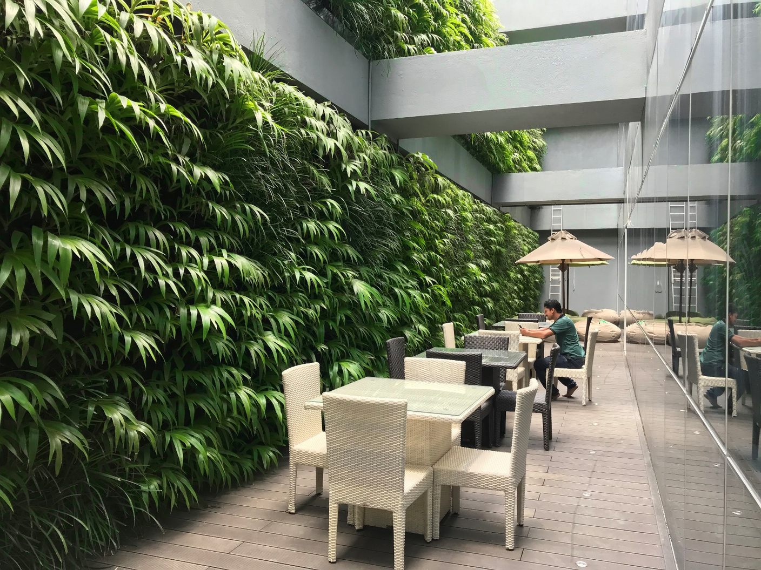
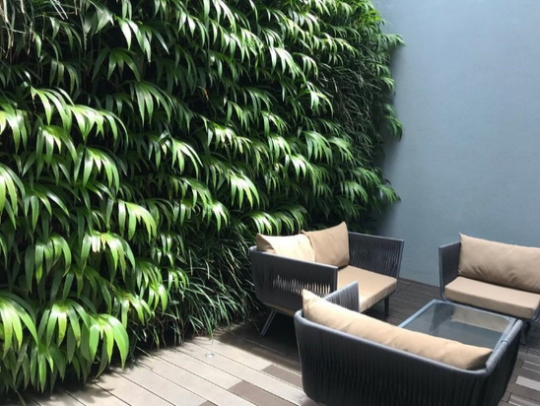

Project References
By Balmond Studio Architects

Slide 25
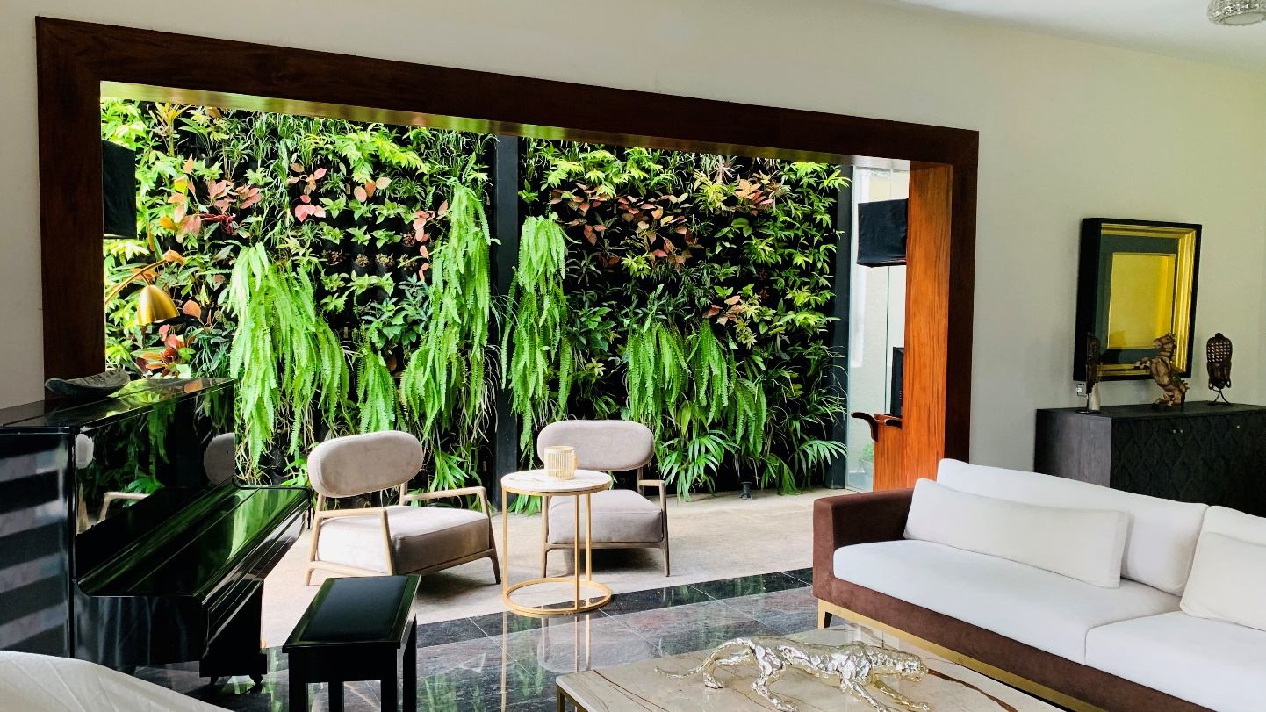
Villa Project

Slide 26
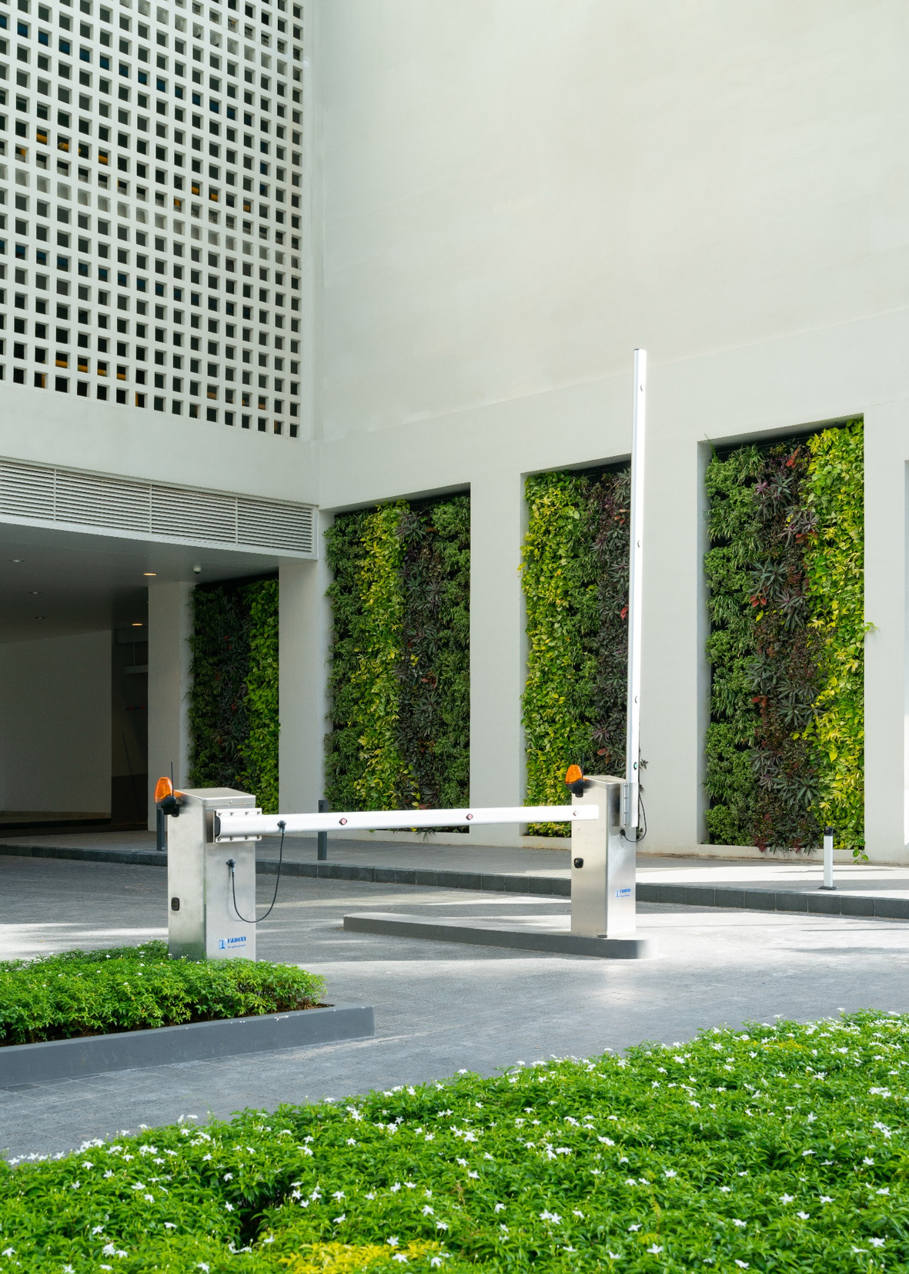
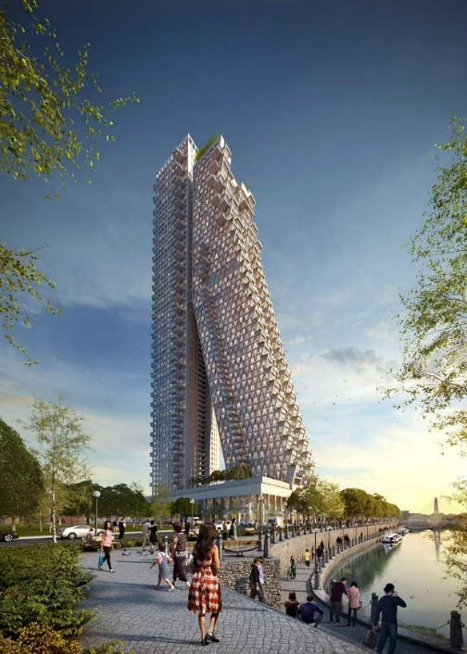
Altair Residencies
Colombo
By Moshe Safdie Architects

Slide 27

Thank You
Corporate member of the Emirates Green Building Council.

